Slide 1
Version control: an insanely useful tool for creation and collaboration
Malcolm Guthrie

Slide 2
Version control and git
version control is a way to manage software which continually changes over time.
It can be viewed as enabling “snapshots” of a project to be saved.
These “snapshots” can be recovered as needed.
It’s also possible to systematically compare different “snapshots” and merge these together
git is a very popular version-control system

Slide 3
some helpful (git) terminology
repository (or “repo”)
noun
a collection of folders and or files containing data (this could be anything: source code, text files, images, mp3s etc)
branch
noun
A “snapshot” of a repo where changes can be made without modifying the original repo. Many branches can exist in parallel (like the limbs of a tree)

Slide 4
some helpful (git) terminology
master or main
noun
Default name for the first branch
merge
noun
process of combining two or more commits or branches

Slide 5
What is github
github is a hosting site for git repositories owned by microsoft
extremely popular (> 372M) with many useful features for code development
For example: github.com/neutrons contains repositories for most current Neutron science directorate software projects

Slide 6
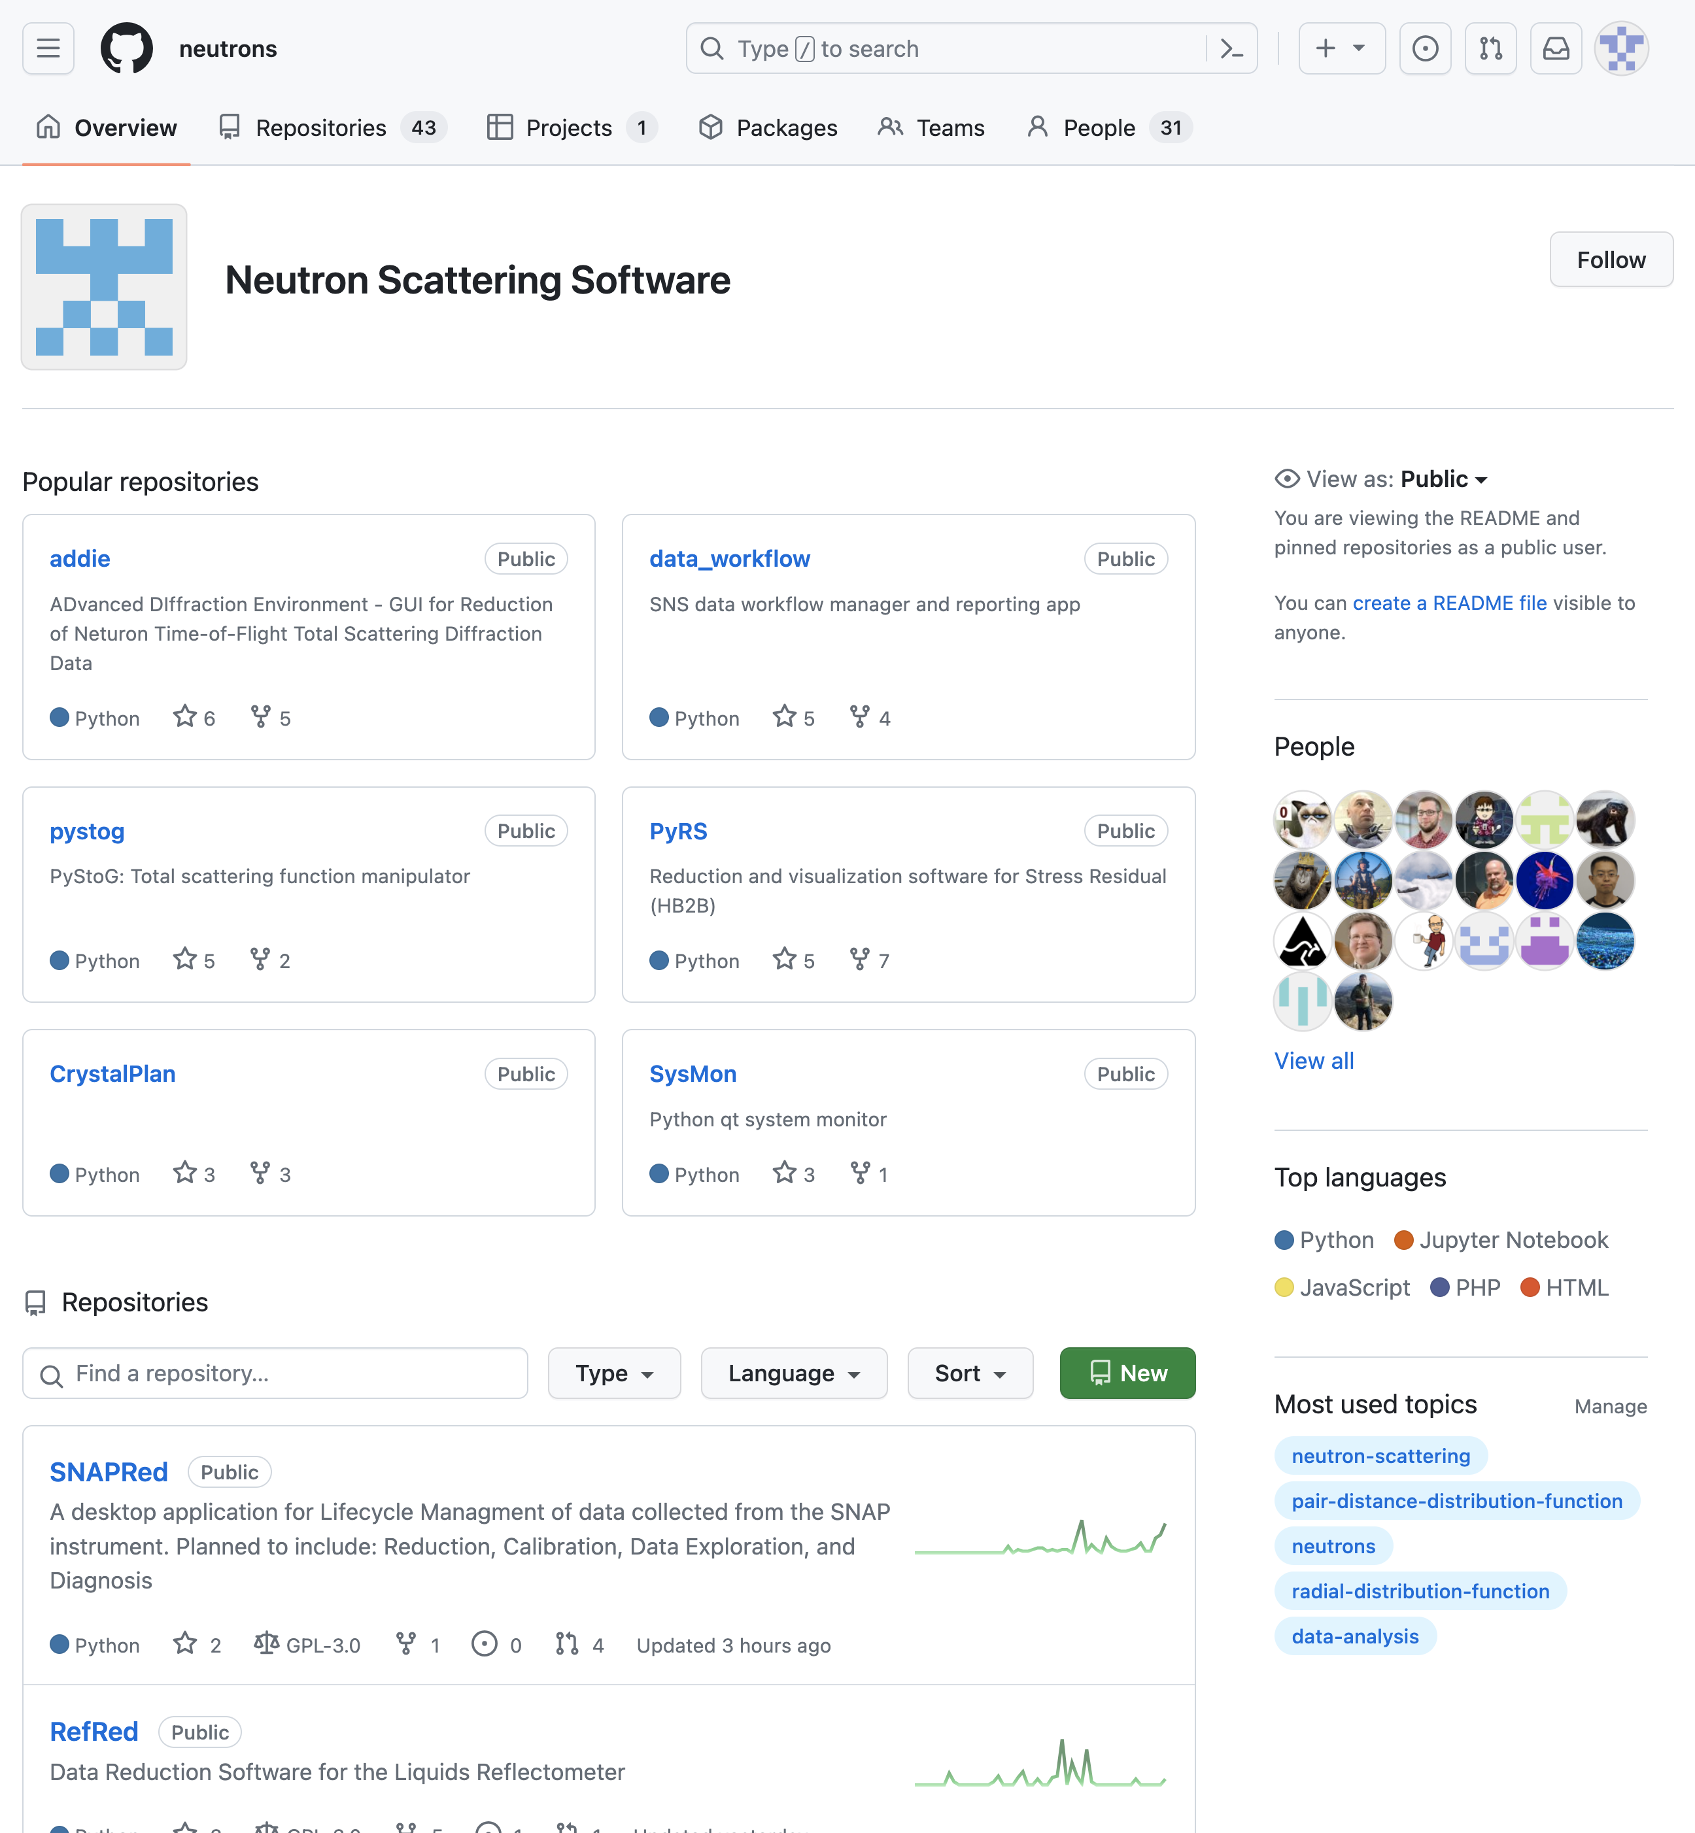

Slide 7
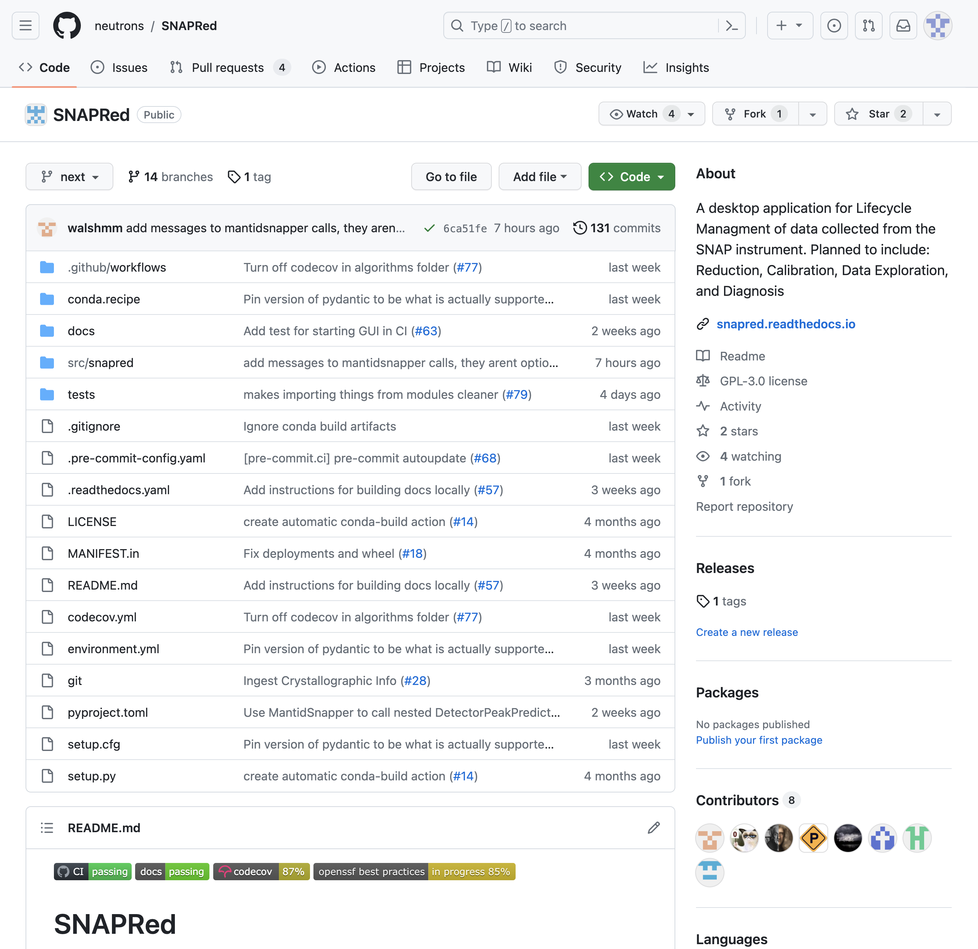
Title of repo

Slide 8
Short description
of project

Slide 9
Branch

Slide 10
readme contains
more detailed
information on project

Slide 11
Contents of repo
(folders and files)

Slide 12
most recent commit
messages

Slide 13
github users who have
committed to repo

Slide 14
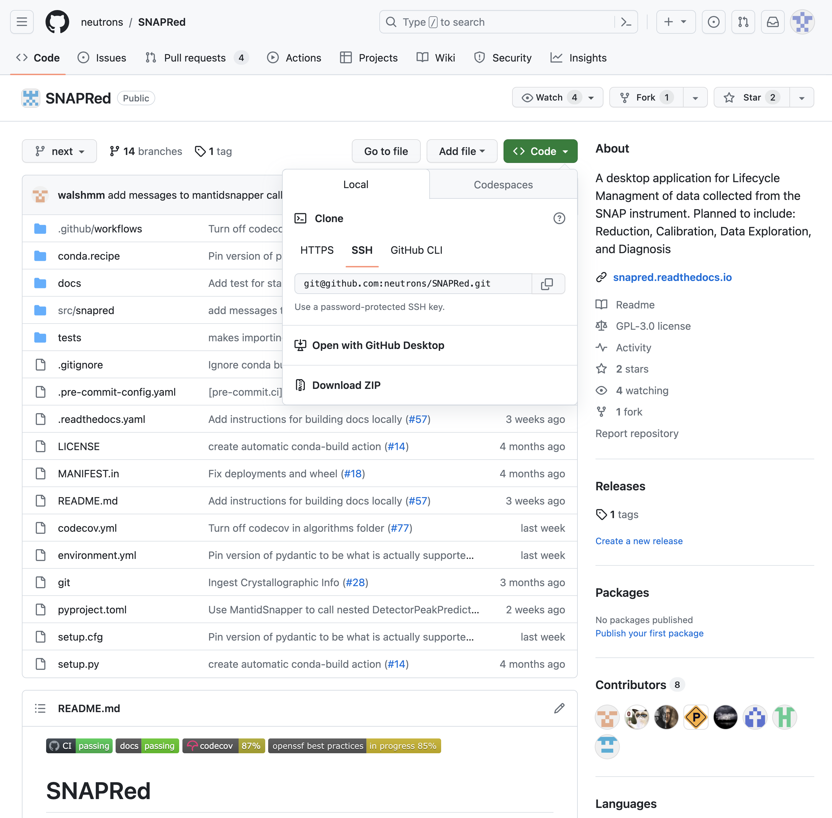
Clicking the green
“Code” button
reveals ways to
download the repo

Slide 15
Cloning a git hub repo
can be done via command line where git is installed.
in github
click code button
copy the HTTPS address (https://github.com/neutrons/SNAPRed.git)
Create a folder to put the repo, go to folder and enter:
$ git clone https://github.com/neutrons/SNAPRed.git
or
$ git clone git@github.com:neutrons/SNAPRed.git
(Latter uses ssh key pair, which must be set up separately on github)

Slide 16
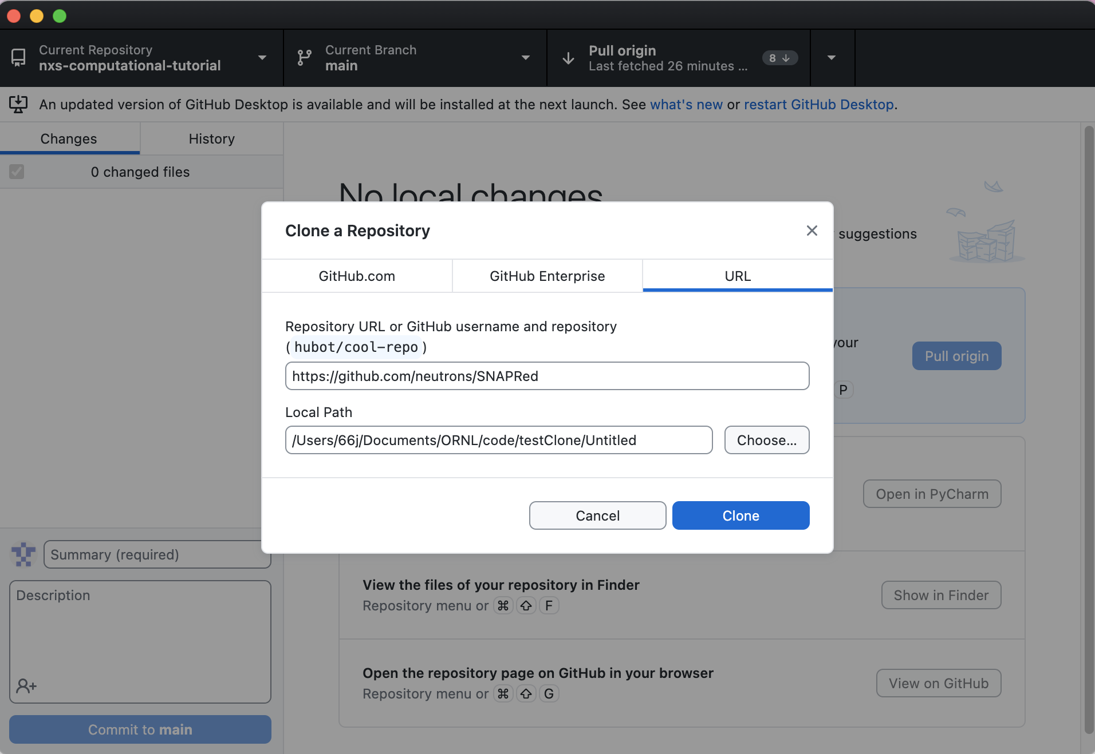
Cloning a git hub repo
Or, even easier, install the github desktop app and click open “with GitHub Desktop”

Slide 17
the “Pull Request”
Pull requests are done when a developer wants changes with they’ve committed to be merged with another branch.
GitHub allows easy code review during a pull request
Automatically compares branches and highlights changes
Allows inline commenting and acception/rejection of changes
In many repos maintain separate development branches and release branches. (mantidworkbenchnightly is the dev branch of mantidworkbench)
Pull requests made to development branch can be tested before final release.

